Slide 1
Primes and Greatest Common Divisors
Course Code: CSC 1204
Course Title: Discrete Mathematics
Dept. of Computer Science
Faculty of Science and Technology
Lecturer No: | 10 | Week No: | 5 | Semester:
Lecturer: | Name & email

Slide 2
Lecture Outline
3.5 Primes and Greatest Common Divisors
Prime and Composite numbers
Fundamental Theorem of Arithmetic
Greatest Common Divisors (gcd)
Least Common Multiple (lcm)
Finding gcd & lcm of two integers using Prime Factorization

Slide 3
Objectives and Outcomes
Objectives: To understand prime and composite numbers, greatest common divisor (gcd) and least common multiple (lcm), how to find gcd and lcm of two integers using prime factorization.
Outcomes: Students are expected to be able explain the terms prime number, composite number, greatest common divisor, least common multiple; be able to determine whether an integer is prime or composite; be able to find the greatest common divisor and least common multiple of two integers using prime factorization.

Slide 4
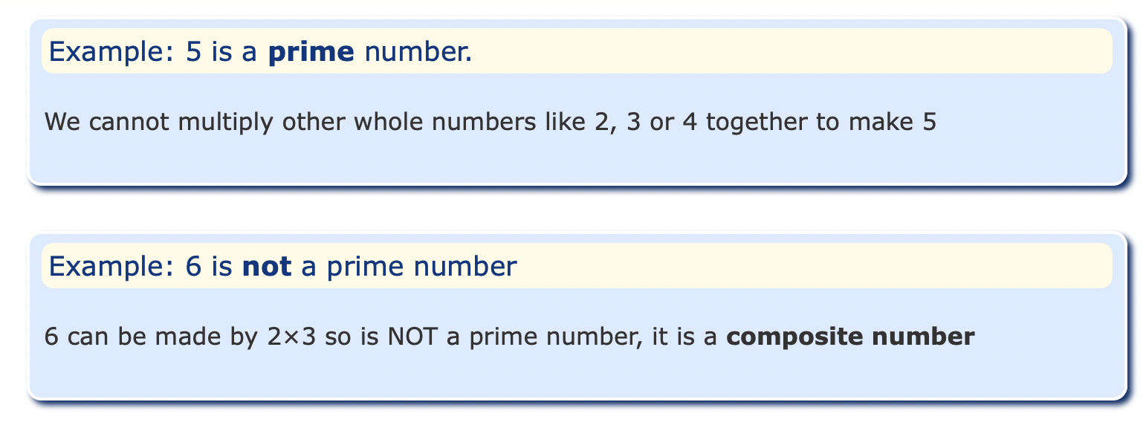

Primes and Composite Numbers
A prime number is an integer number above 1 that cannot be made by multiplying other integer numbers expect 1 and that number. The first few prime numbers are: 2, 3, 5, 7, 11, 13, 17, 19 and 23

Slide 5
Primes and Composite Numbers
Definition 1: A positive integer p greater than 1 is called prime if the only positive factors of p are 1 and p.
A positive integer that is greater than 1 and is not prime is called composite.
  Note: The integer n is composite if and only if there exists an integer a such that a|n and 1 < a < n.
Theorem 3: There are infinitely many primes.

Slide 6
Example 1 (p. 223)
The integer 7 is prime because its only positive factors are 1 and 7, whereas the integer 9 is composite because it is divisible by 3.
Question: What are the primes less than 100?

Slide 7
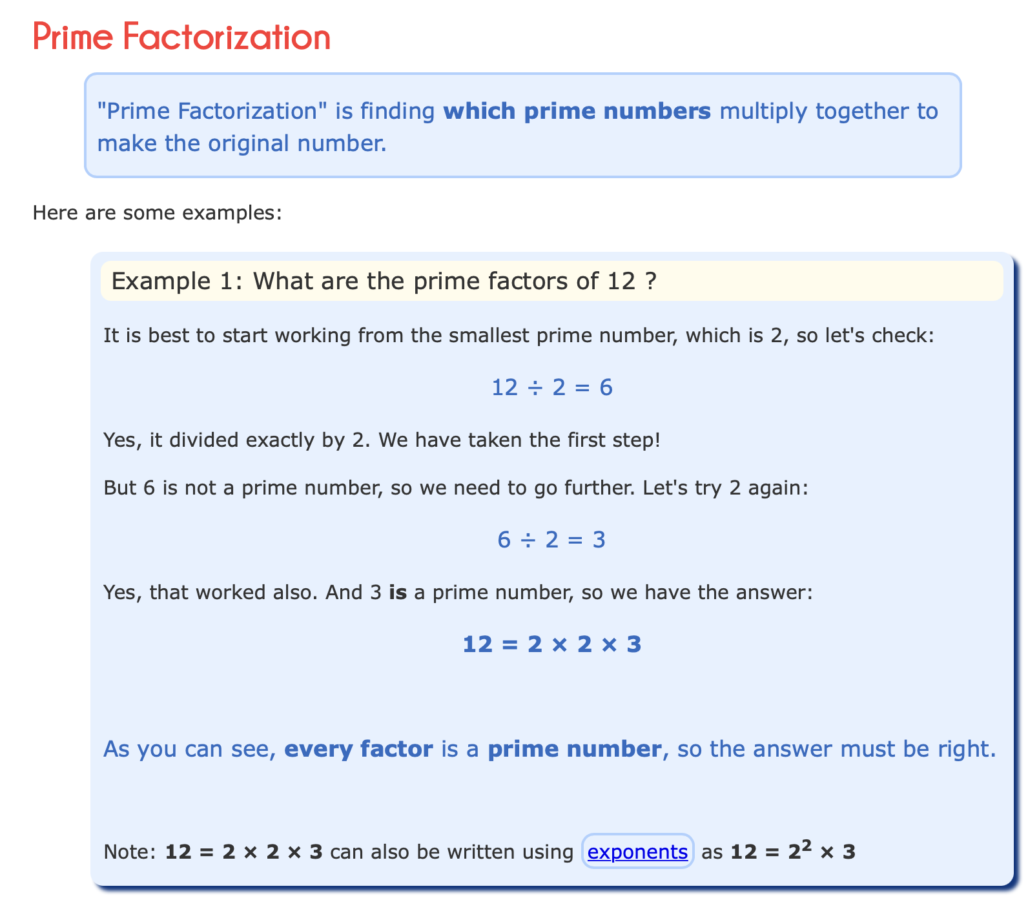
Primes and Composite Numbers

Slide 8
Fundamental Theorem of Arithmetic
Theorem 1(Fundamental Theorem of Arithmetic): Every positive integer greater than 1 can be written uniquely as a prime or as the product of two or more primes where the prime factors are written in order of non-decreasing size.
Example 2 (p.224) : Prime factorization of 100, 641, 999, and 1024 are given by
  100 = 2.2.5.5 = 2².5²
  641 = 641
  999 = 3.3.3.37 = 3³.37
  1024 = 2.2.2.2.2.2.2.2.2.2 = 2¹⁰

Slide 9
Interesting facts about prime numbers
Two is the only even Prime number.
Every prime number can be represented in form of 6n+1 or 6n-1 except the prime number 2 and 3, where n is a natural number.
Two and Three are only two consecutive natural numbers that are prime.
Goldbach Conjecture: Every even integer greater than 2 can be expressed as the sum of two primes. - but remains unproven despite considerable effort
Wilson Theorem: Wilson’s theorem states that a natural number p > 1 is a prime number if and only if
(p - 1) ! ≡ -1 mod p
OR (p - 1) ! ≡ (p-1) mod p
How we check whether a number is Prime or not?
Naive solution: A naive solution is to iterate through all numbers from 2 to sqrt(n) and for every number check if it divides n. If we find any number that divides, we return false.

Slide 10
There are some formulas which can be used to find the primes. To check whether a large number is a prime number or not, follow the steps given below:
Step 1: Check the units place of that number. If it ends with 0, 2, 4, 6 and 8, it is not a prime number. Note: “Numbers ending with 0, 2, 4, 6 and 8 are never prime numbers.”
Step 2: Take the sum of the digits of that number. If the sum is divisible by 3, the number is not a prime number. Note: “Numbers whose sum of digits are divisible by 3 are never prime numbers.”
Step 3: After confirming the falsity of steps 1 and 2, find the square root of the given number.
Step 4: Divide the given number by all the prime numbers below its square root value.
Step 5: If the number is divisible by any of the prime numbers less than its square root, it is not a prime number; otherwise, it is prime.
Exception: If a large number is ending with 5, then it is always divisible by 5. Hence, it is not a prime number

Slide 11
Determining whether a given integer is Prime or Composite
Theorem 2: If n is a composite integer, then n has a prime divisor less than or equal to √n.
From Theorem 2, it follows that an integer is prime if it is not divisible by any prime less than or equal to its square root.

Slide 12
Determining whether a given integer is Prime or Composite
Example 3 [p.224]: Show that 101 is prime.
Solution: The only primes not exceeding √101 are 2, 3, 5, 7. Because 101 is not divisible by 2, 3, 5, or 7, it follows that 101 is prime.
Exercise 1(e)[p.230]: Determine whether 111 is prime.
Solution: The only primes not exceeding √111 are 2, 3, 5, 7. Because 111 is divisible by 3, it follows that 111 is not prime.
Exercise 1(f)[p.230]: Determine whether 143 is prime.
Solution: The only primes not exceeding √143 are 2, 3, 5, 7,11. Because 143 is divisible by 11, it follows that 143 is not prime.
Extra example: Test if 139 is prime.

Slide 13
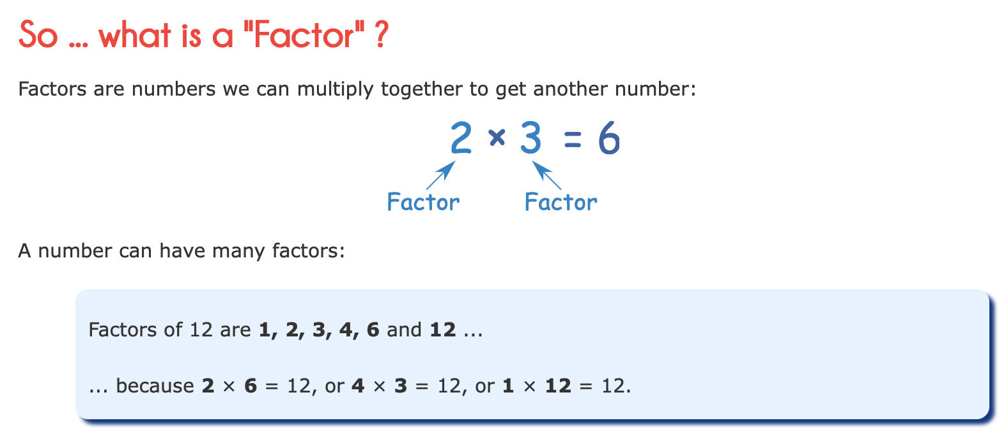
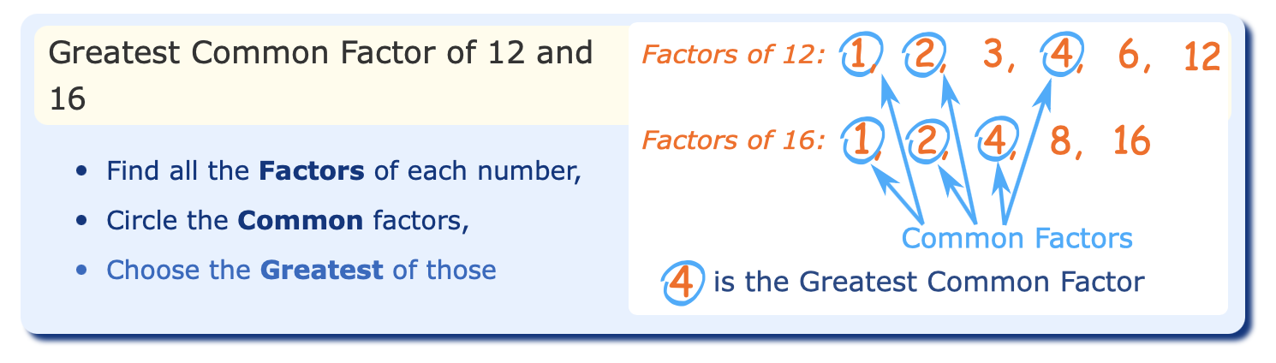

Slide 14
Greatest Common Divisor(gcd)
Definition 2: Let a and b be integers, not both zero. The largest integer d such that d | a and d | b is called the greatest common divisor of a and b.
    The greatest common divisor of a and b is denoted by gcd(a, b)
Example 10 (p.228): What is the greatest common divisor of 24 and 36?
Solution: The positive common divisors of 24 and 36 are 1, 2, 3, 4, 6, and 12. Hence gcd(24,36) = 12

Slide 15
Relatively Prime
Definition 3: The integers a and b are relatively prime if their gcd is 1.
Example 11 (p.228): What is the gcd of 17 and 22?
Solution: The integers 17 and 22 have no positive common divisors other than 1, so that gcd(17,22) = 1
By Example 11, it follows that the integers 17 & 22 are relatively prime, because gcd(17,22) = 1

Slide 16
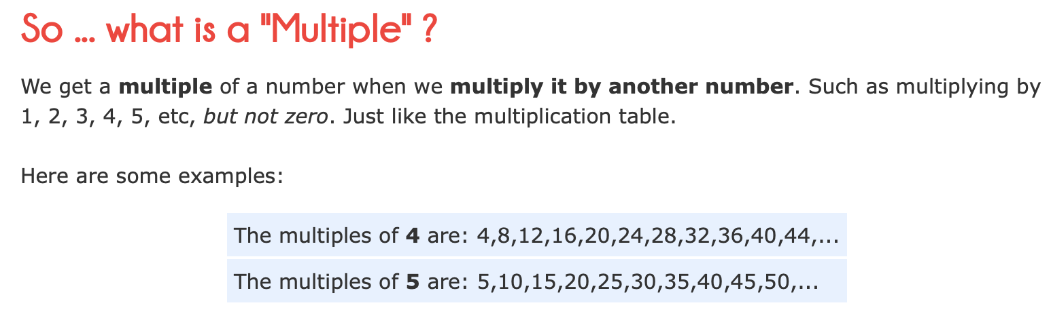
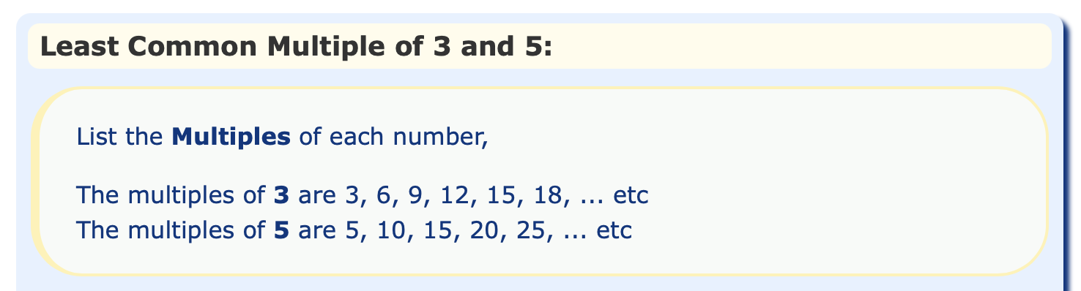
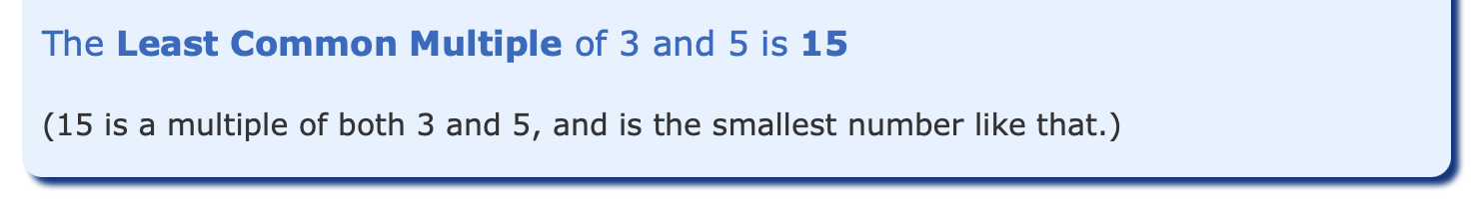

Slide 17
Least Common Multiple(lcm)
Definition 5: The least common multiple of positive integers a and b is the smallest positive integer that is divisible by both a and b.
    The least common multiple of a and b is denoted by lcm(a, b)
Theorem 5: Let a and b be positive integers. Then
ab = gcd(a, b) . lcm(a, b)

Slide 18
Finding gcd & lcm of two integers using Prime Factorization
We can find the greatest common divisor (gcd), or least common multiple (lcm) of two integers using the prime factorization of these integers.
Let prime factorization of the integers a and b, neither equal to zero, are a = p₁^{a1} p₂^{a2} ….. p_{n}ª _{n} ,
b = p₁^{b1} p₂^{b2} …... p_{n}^{b} _{n}
gcd(a, b) = p₁^{min(a1, b1)} p₂^{min(a2, b2)} ………p_{n}^{min(an , bn)}
lcm(a, b) = p₁^{max(a1, b1)} p₂^{max(a2, b2) ………}p_{n}^{max(an , bn)}

Slide 19
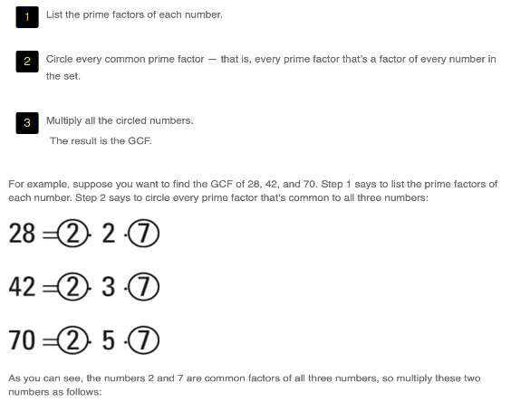
Finding GCD using prime factors
As you can see, the numbers 2 and 7 are common factors of all three numbers, so multiply these two numbers as follows: 2 × 7 = 14
Thus, the GCD of 28, 42, and 70 is 14.

Slide 20
Finding LCM using prime factors
Step 1: List the prime factors of each number. Suppose you want to find the LCM of 18 and 24. List the prime factors of each number:
18 = 2 × 3 × 3
24 = 2 × 2 × 2 × 3
Step 2.For each prime number listed, underline the most repeated occurrence of this number in any prime factorization. The number 2 appears once in the prime factorization of 18 but three times in that of 24, so underline the three 2s:
18 = 2 × 3 × 3
24 = 2 × 2 × 2 × 3
Similarly, the number 3 appears twice in the prime factorization of 18 but only once in that of 24, so underline the two 3s:
18 = 2 × 3 × 3
24 = 2 × 2 × 2 × 3
Step 3. Multiply all the underlined numbers. Here’s the product:
2 × 2 × 2 × 3 × 3 = 72
So the LCM of 18 and 24 is 72. This solution checks out because
18 × 4 = 72
24 × 3 = 72

Slide 21
Example 14(p. 229)
What is the gcd of 120 and 500?
Solution: Because the prime factorization of 120 and 500 are 120 = 2³.3.5 and 500 = 2².5³ , the greatest common divisor is
gcd(120,500) = 2^{min(3,2)} 3^{min(1,0)} 5^{min(1,3)}
= 2² 3⁰ 5¹
= 20
[Note: 500 = 2². 3⁰.5³ ]

Slide 22
Class Work
Find the lcm(120,500), and then prove the theorem
ab = gcd(a, b) . lcm(a, b) , where a =120, and b = 500.
2. Find the gcd and lcm of 200 and 700 using prime
factorization.

Slide 23
Example 15(p. 230)
What is the least common multiple(lcm) of 2³3⁵7² and 2⁴3³?
Solution:
lcm (2³3⁵7² , 2⁴3³⁾ = 2^{max(3,4)}3^{max(5,3)}7^{max(2,0)}
= 2⁴3⁵7²
[Note: 7⁰ = 1]

Slide 24
Practice @ Home
Relevant odd-numbered Exercises from your text book

Slide 25
Books
Discrete Mathematics and its applications with combinatorics and graph theory (7th edition) by Kenneth H. Rosen [Indian Adaptation by KAMALA KRITHIVASAN], published by McGraw-Hill

Slide 26
References
Discrete Mathematics, Richard Johnsonbaugh, Pearson education, Inc.
Discrete Mathematical Structures, Bernard Kolman, Robert C. Busby, Sharon Ross, Prentice-Hall, Inc.
SCHAUM’S outlines Discrete Mathematics(2nd edition), by Seymour Lipschutz, Marc Lipson

